Slide 1
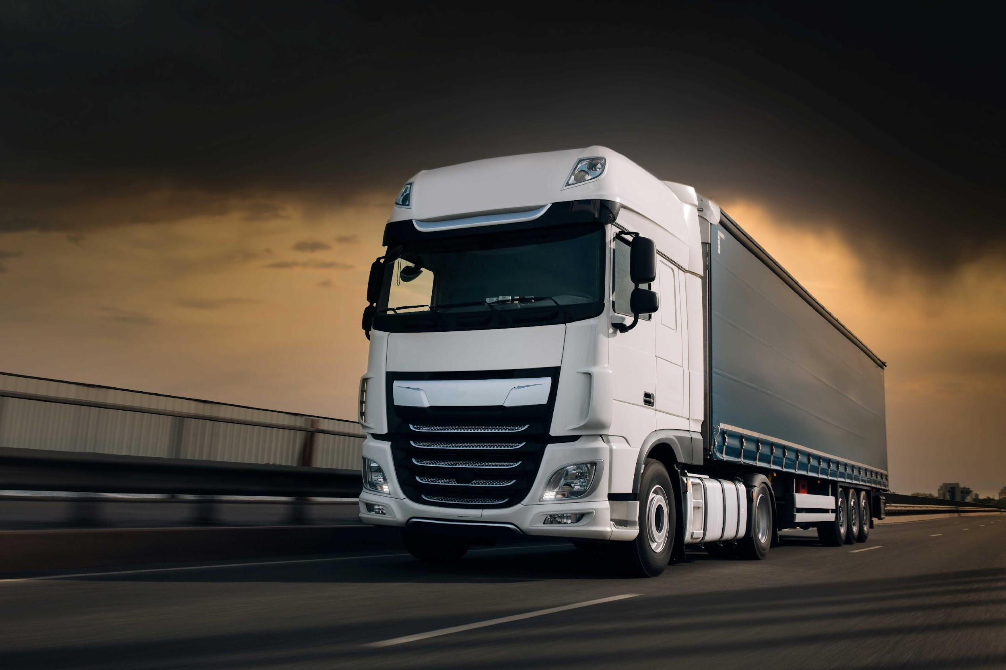
AI On The Road: The Role Of Video-capturing Technology In Improving Driver Safety And Accident Prevention.

Slide 2

BACKGROUND
Artificial intelligence (AI) holds immense potential to significantly enhance road safety and operational efficiency in the trucking industry.
Originally defined by John McCarthy as the science of creating intelligent machines, AI provides innovative solutions to pressing issues like driver distraction and fatigue, which are major causes of road accidents.
This research focuses on exploring the role of video-capturing technology in improving driver safety and preventing accidents.

Slide 3

PROBLEM STATEMENT
Road safety is a fundamental human right and is emphasized in constitutional acts like those in Canada, highlighting its societal importance.
Driver distraction and fatigue are major contributors to fatal collisions, indicating the critical need for comprehensive solutions. (Ministry of Transport, 2022)
The automotive industry, supported by technology companies, is integrating AI and ML systems, such as onboard cameras, to enhance safety, however questions about their accuracy and reliability remain.

Slide 4

RESEARCH QUESTIONS
Precision of AI Technology: What level of precision does video-capturing AI technology achieve in proactively anticipating potential risk scenarios by analyzing driver behavior patterns and external variables to prevent accidents?
Effectiveness Comparison: How does video capturing AI might be more effective to identify driver’s behavior in comparison to human supervisors or traditional systems?
Impact on Road Safety: How is the integration of video-capturing AI technology within the trucking industry contributing to advancements in road safety?

Slide 5

OBJECTIVES
To determine the current utilization of video-capturing AI in the trucking industry.
To assess the precision of AI technology in predicting potential risk scenarios by analyzing driver behavior patterns.
To assess the efficiency of video-capturing AI in monitoring driver behavior in real-time compared to traditional systems.
To gather industry feedback on the effectiveness of video-capturing AI in enhancing road safety.

Slide 6

LITERATURE REVIEW
Real-Time Driver Fatigue Detection Systems:
Civik & Yuzgec (2023): Utilizes cameras and CNNs for monitoring eye and mouth movements with high accuracy.
Comprehensive Driver Behavior Analysis Framework:
Zhang et al. (2024): A seven-step framework including facial expressions, hand-object interaction, and risk assessment.
EEG-Based Fatigue Detection:
Zheng et al. (2022): Combines EEG data with ML algorithms to detect fatigue by analyzing brain signals.
Notes:
Driver behavior analysis has been a focal point of road safety research, with various studies exploring different methods to detect risky behaviors. …
Recent advancements in AI, particularly in computer vision and machine learning, have led to the development of sophisticated systems capable of real-time driver monitoring. These systems can detect behaviors such as distraction, drowsiness, and non-compliance with safety regulations, significantly enhancing road safety. …
Despite these advancements, most research has been conducted in controlled environments, which may not fully reflect the challenges faced in the trucking industry. Additionally, the ethical implications of using AI to monitor drivers, particularly concerning privacy, require further exploration. …

Slide 7
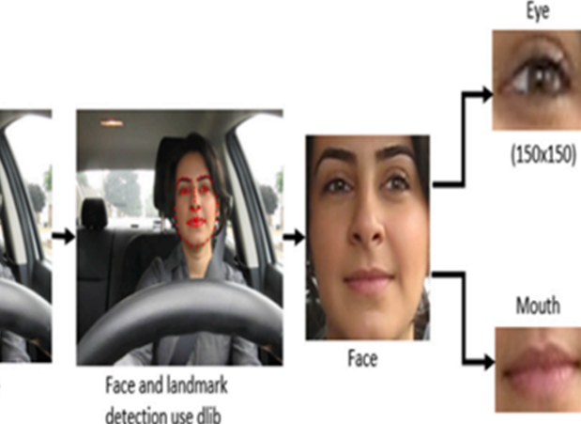
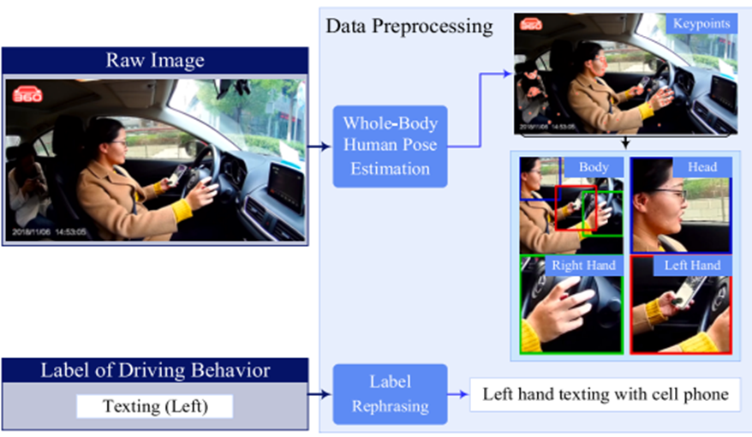
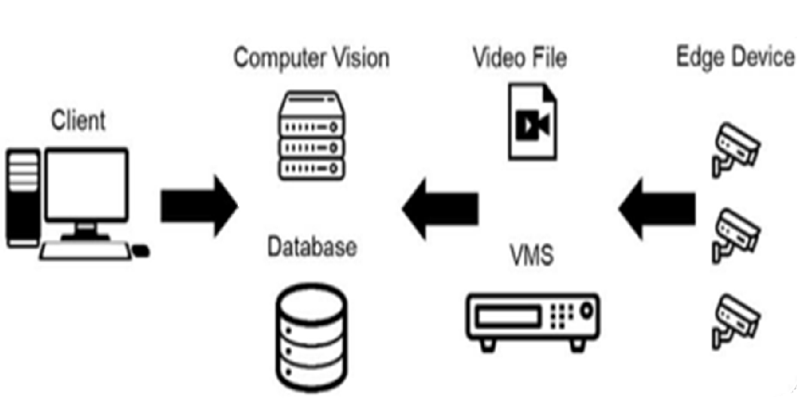
LITERATURE REVIEW
Technological Advancements
FRONT CAMERA
SIDE CAMERA
CENTRAL VIDEO M. SYSTEM
Notes:
Driver behavior analysis has been a focal point of road safety research, with various studies exploring different methods to detect risky behaviors. …
Recent advancements in AI, particularly in computer vision and machine learning, have led to the development of sophisticated systems capable of real-time driver monitoring. These systems can detect behaviors such as distraction, drowsiness, and non-compliance with safety regulations, significantly enhancing road safety. …
Despite these advancements, most research has been conducted in controlled environments, which may not fully reflect the challenges faced in the trucking industry. Additionally, the ethical implications of using AI to monitor drivers, particularly concerning privacy, require further exploration. …

Slide 8
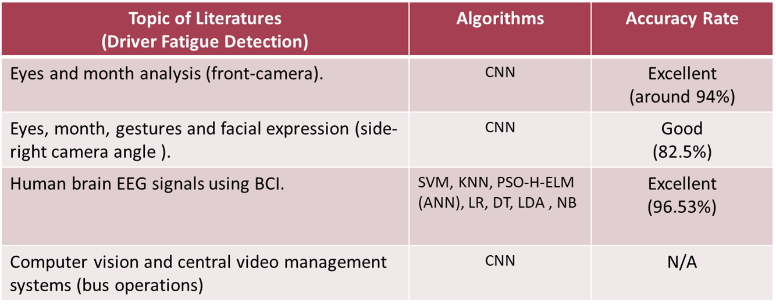
LITERATURE REVIEW
Technological Advancements
After exploring 82 existing literatures and evaluating 8 different ML models. It can conclude that CNN model is the most suitable technique for driving behavior analysis.
Notes:
Driver behavior analysis has been a focal point of road safety research, with various studies exploring different methods to detect risky behaviors. …
Recent advancements in AI, particularly in computer vision and machine learning, have led to the development of sophisticated systems capable of real-time driver monitoring. These systems can detect behaviors such as distraction, drowsiness, and non-compliance with safety regulations, significantly enhancing road safety. …
Despite these advancements, most research has been conducted in controlled environments, which may not fully reflect the challenges faced in the trucking industry. Additionally, the ethical implications of using AI to monitor drivers, particularly concerning privacy, require further exploration. …

Slide 9
TRUCKING INDUSTRY - KEY CONSIDERATIONS

Slide 10





TRUCKING INDUSTRY: OPERATIONS AND PLAYERS
Trucking Company
Courier
Shipper
Producer
Wholesaler
Freight Broker
Retailer
Consumer
LONG HAUL (Project’s target)
LAST MILE (Out of scope)
Notes:
The trucking industry is essential for moving goods over land and is a vital part of the supply chain. Let’s break down the main players and how the operation flows:
Operation Flow:
Consumers place orders with retailers or shippers.
Shippers prepare and package goods.
Trucking companies pick up and transport goods to retailers or directly to consumers.
Retailers receive and store goods, preparing them for final delivery.
Couriers handle the last-mile delivery to consumers.
By coordinating these steps, the trucking industry ensures efficient movement of goods, meeting the needs of all players involved.
The shipper, who can be the producer, wholesaler or broker, demands transport services to move large volumes of cargo from the industry to the retailer. This operation is known as long haul. The retailer, in turn, requires transportation services to move several small volumes of cargo to the final consumer in an operation known as last mile.
Our project focuses on long-haul operations and its players are the carrier and those who demand its service.

Slide 11

TRUCKING INDUSTRY: RISK CONSIDERATION
Trucking Company
Shippers
Retailer
Shipping Models | Risk Transfer *
 | Goods | Vehicle
CIF (Cost, Insurance, And Freight) | Shipper | Trucking C.
FOB (Free On Board) | Retailer | Trucking C.
Shared risk may be considered.
Notes:
There are two concepts of supply chain management.
CIF model and FOB model.
In CIF model Shippers are responsible for cost, insurance and freight of the goods whereas in FOB model Retailer are responsible for safely transporting the goods. In CIF, the risk and responsibility transfer from the shippers to the retailer/buyer at the destination port.
In FOB, the risk and responsibility transfer from the shipper to the retailer/buyer when the goods are loaded onto the shipping vessel at the port of origin. Considering that we are talking about road safety, it is important to understand who suffers the financial consequences in the event of an accident.
This brings us to two important concepts known as CIF and FOB.
CIF means that the responsibility and risk of transporting the cargo lies with the seller.
As for FOB, the responsibility and risk lies with the buyer.
These concepts are important as our project will show that our population goes beyond just truck drivers. It also includes the shipper and other functions in a road freight transport company.

Slide 12

RESEARCH METHODOLOGY
Philosophical Paradigm
A pragmatic approach, focusing on the practical outcomes of AI implementation in the trucking industry.
This study adopts a pragmatic approach, focusing on the practical outcomes of AI implementation in the trucking industry. The research is designed to provide actionable insights that can be directly applied to improve road safety.
Notes:
This study adopts a pragmatic approach, focusing on the practical outcomes of AI implementation in the trucking industry. The research is designed to provide actionable insights that can be directly applied to improve road safety. This research takes a practical approach, concentrating on the real-world effects of AI implementation in the trucking industry. The study aims to deliver actionable insights that can be immediately applied to enhance road safety.

Slide 13







RESEARCH METHODOLOGY
Research Design
A mixed-methods approach combining quantitative analysis of video data with qualitative insights from industry experts.
Sampling Design:
Instruments:
Semi-structured
interview
North America and Latam
Long Haul Operations
Truck Drivers and Industry Experts
Onboard Cameras
Smartphone
Mobile App
Machine Learning
(Convolution Neural Network)
Notes:
This study adopts a pragmatic approach, focusing on the practical outcomes of AI implementation in the trucking industry. The research is designed to provide actionable insights that can be directly applied to improve road safety.
Industry experts like fleet managers, truck drivers, supervisors, company owners with at least 2 years of experience

Slide 14




RESEARCH METHODOLOGY
Qualitative Data Analysis
Thematic analysis employed to detect patterns and themes from interview responses provided by industry experts, thereby obtaining contextual insights.
03 Trucking Ind. Employees
Trucking companies
Fuel, Refrigerated and others
700 trucks (approx)
Latam and Canada
AI Experience
02 Truck Drivers
Employees
Long Haul Operations
Canada, USA, Brazil and Australia
20+ years driving experience
No AI experience
01 Transportation Specialist
Shipper (Downstream Oil)
40 trucking companies (approx)
up to 5.000 trucks
Brazil
AI Experience
01 Tech Consultant
Fleet M. Solution Provider
Trucking, Shipper, Insurance
Brazil and Mexico
AI experience

Slide 15
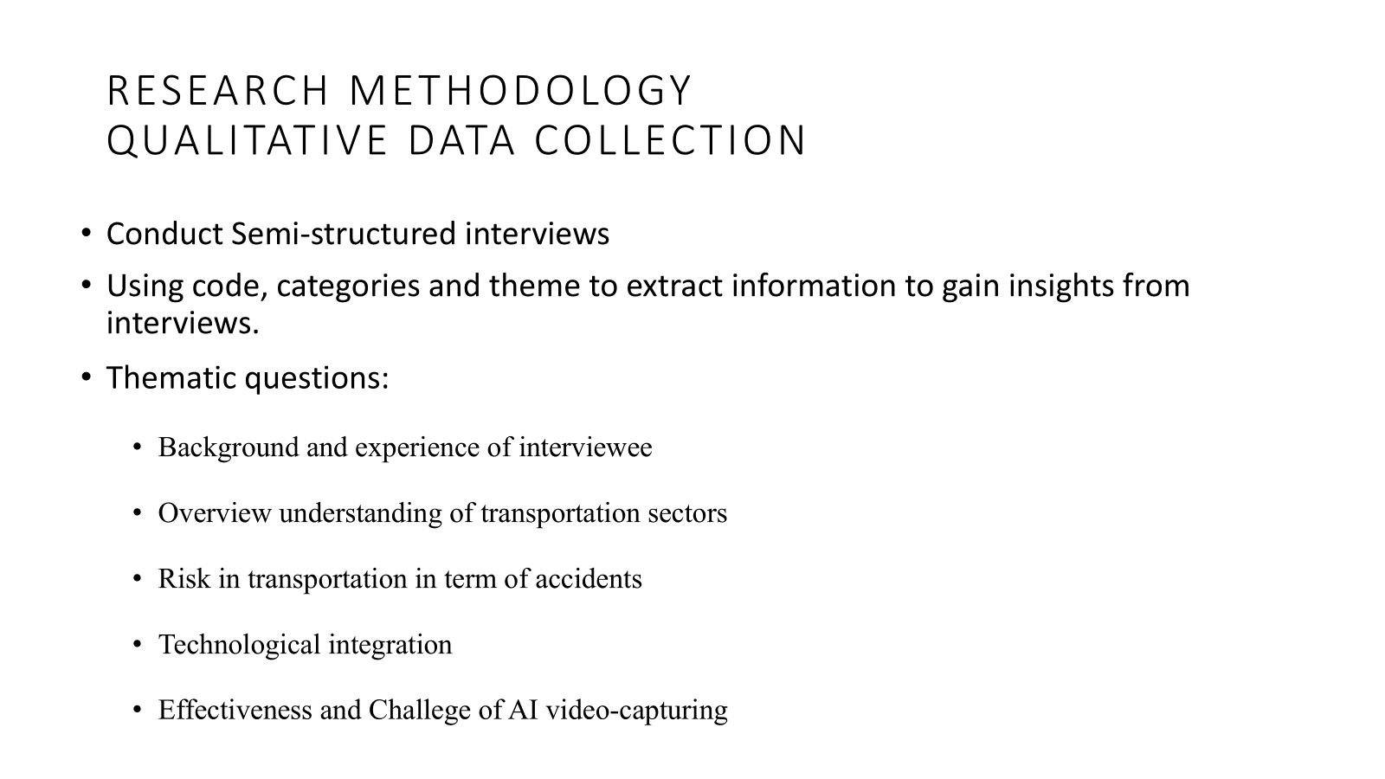

Slide 16
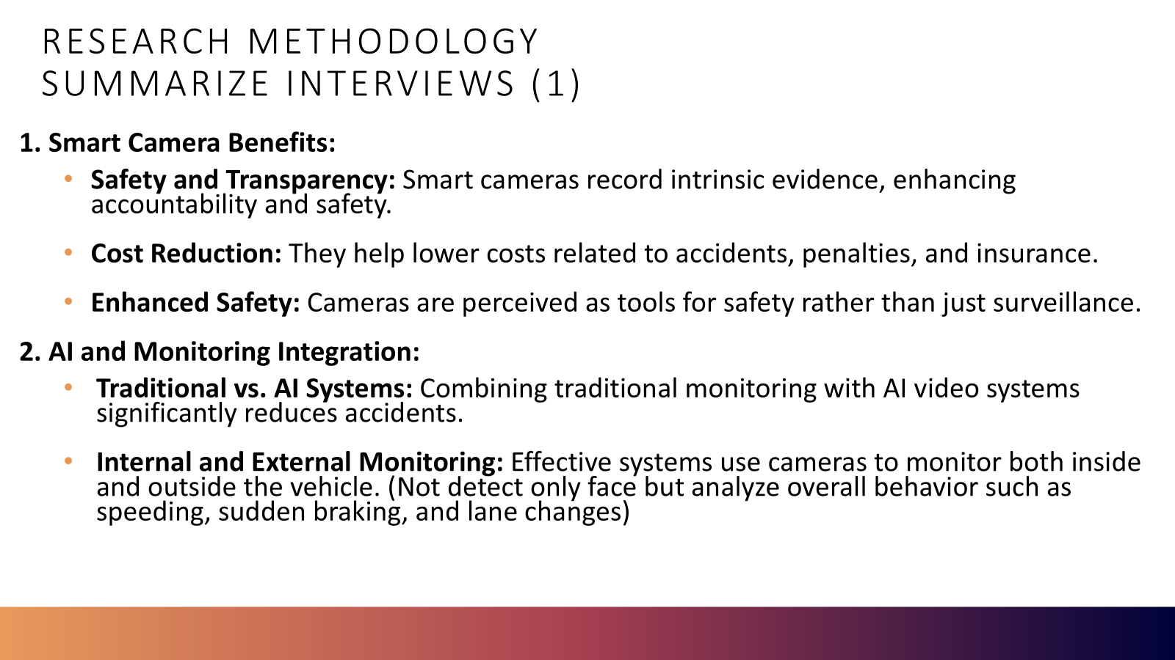

Slide 17
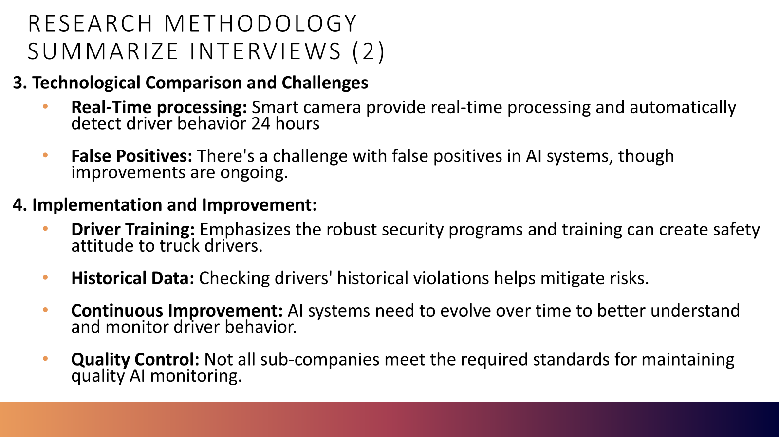

Slide 18
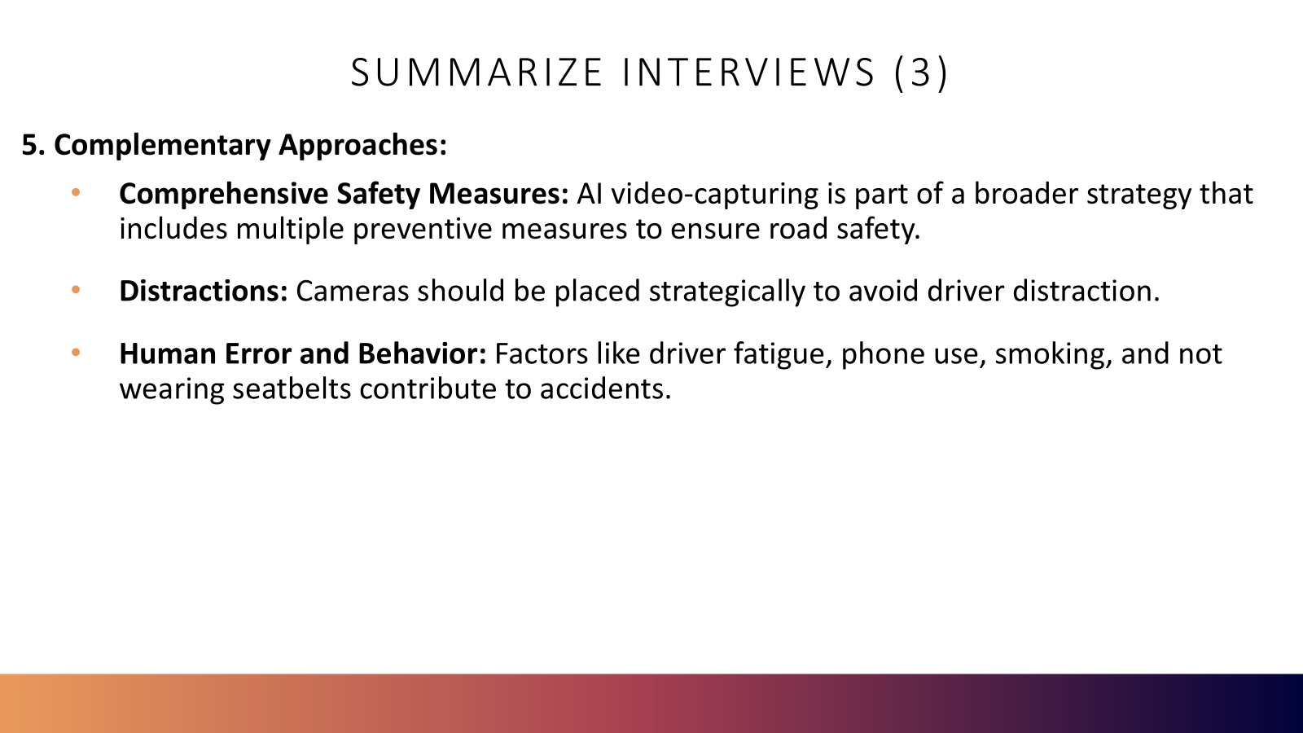

Slide 19

RESEARCH METHODOLOGY
Quantitative Data Analysis
Statistical analysis to evaluate the performance of machine Learning models in identifying risk situations that lead to accidents.
Data collection: Driver’s behavior and physical condition captured by cameras installed inside the truck cabin.
Features Analyzed
Fatigue
Distraction
Closed Eyes
Irregular Blinking
Head
(Looking up, down and side)
Object Detection
Unstable Head

Slide 20
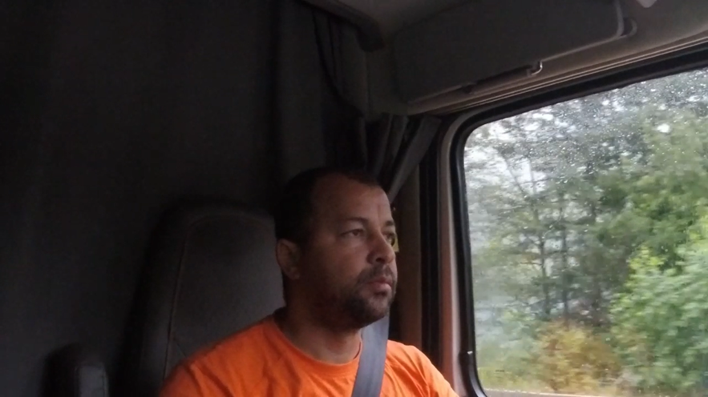
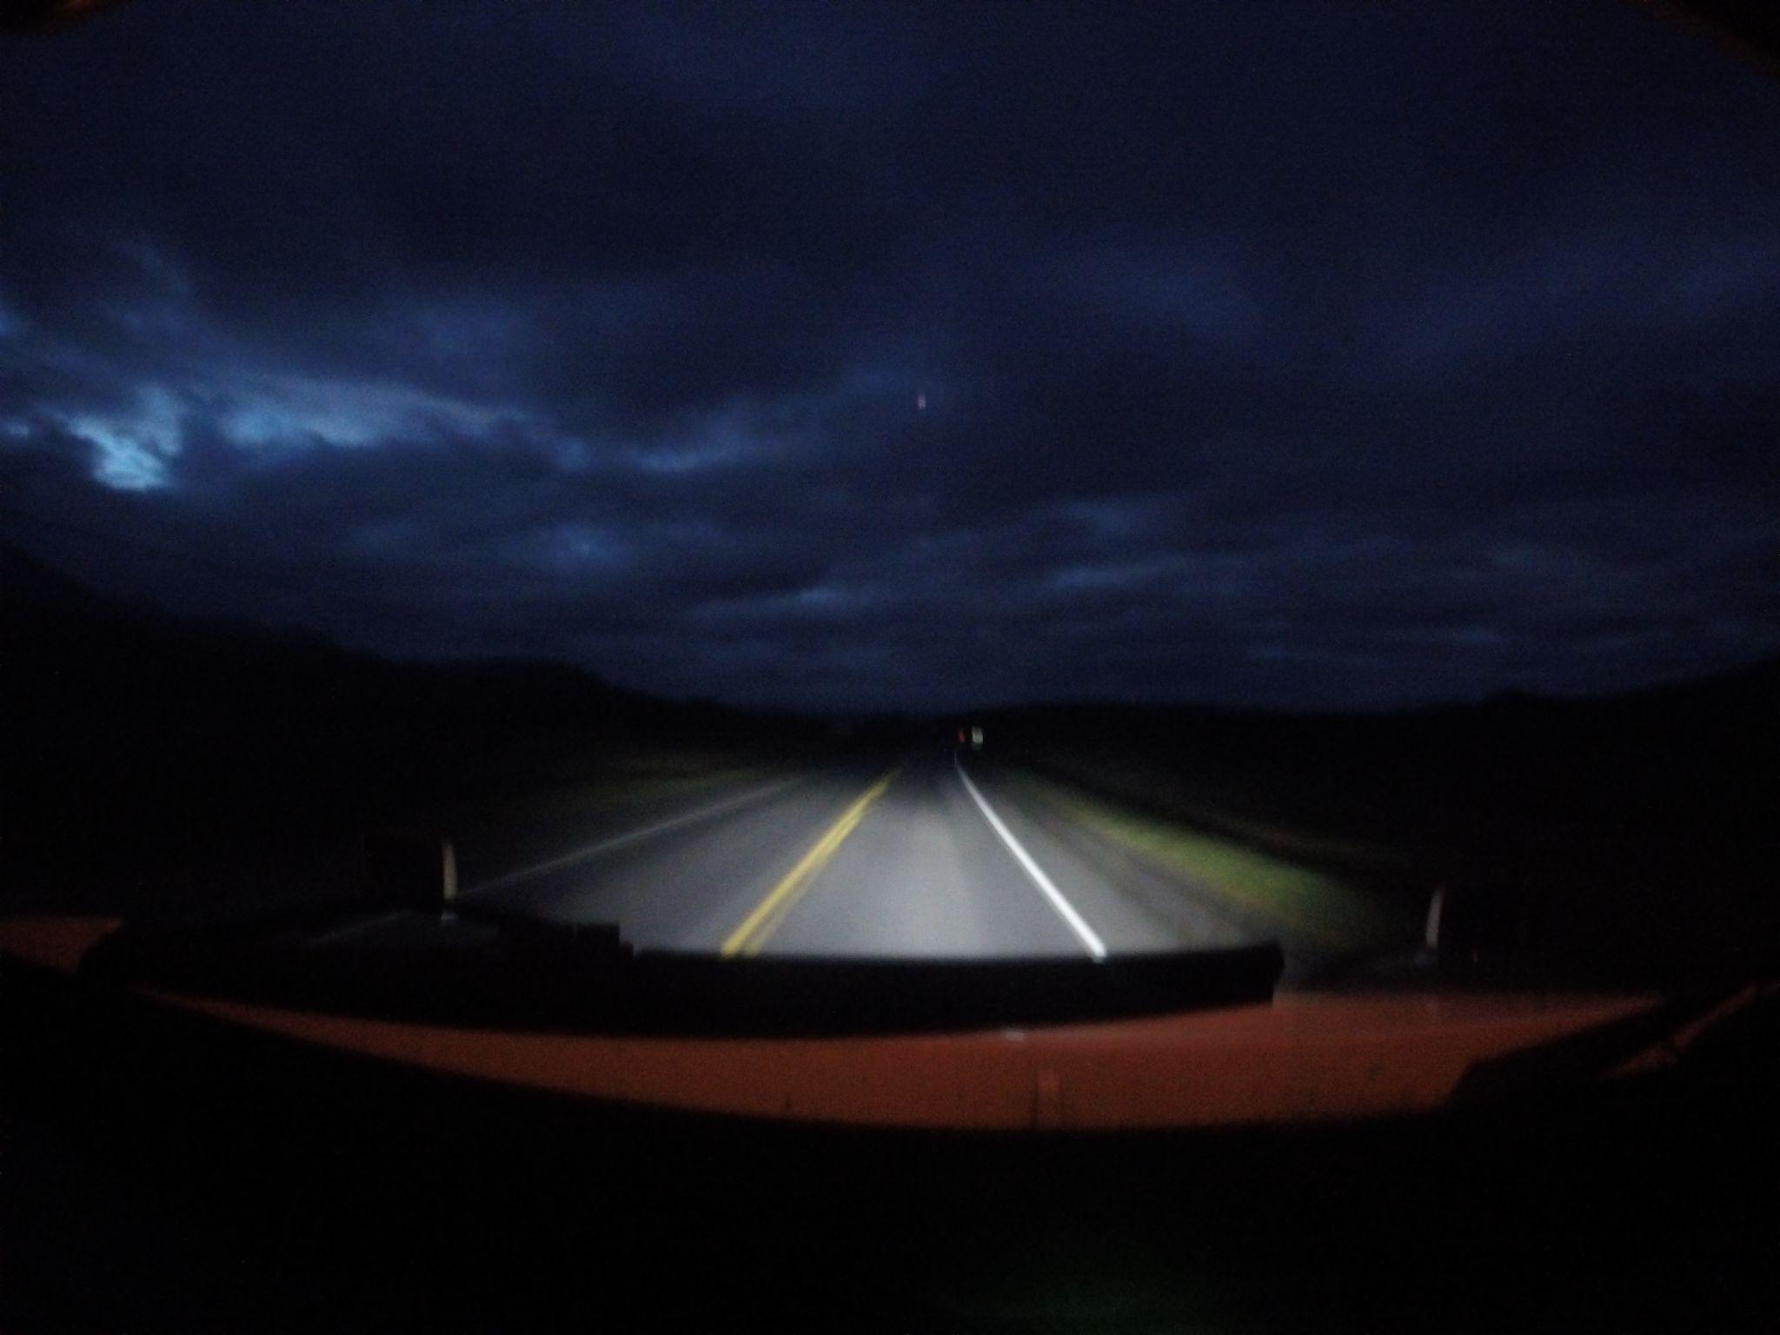
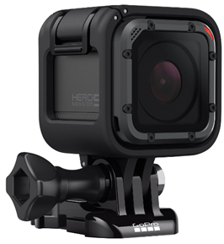
RESEARCH METHODOLOGY
Data Collection - Experiment One
North America
INTERNAL VIEW
FRONT VIEW

Slide 21
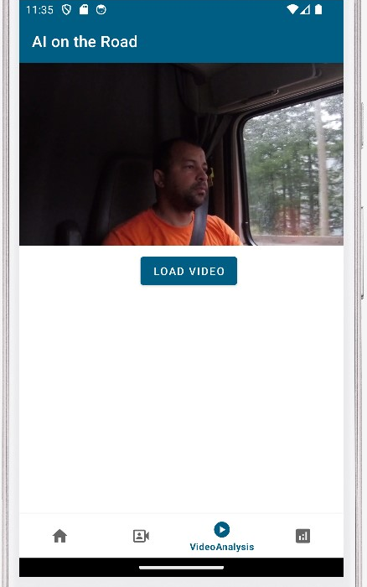
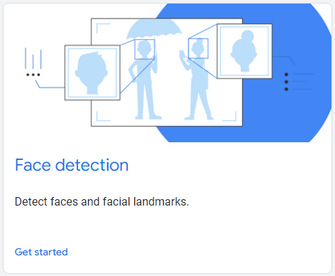
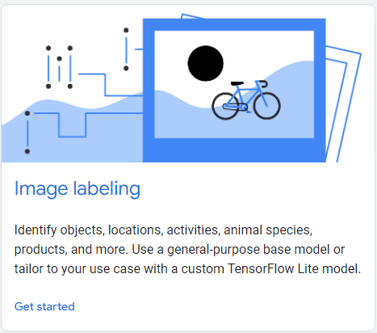
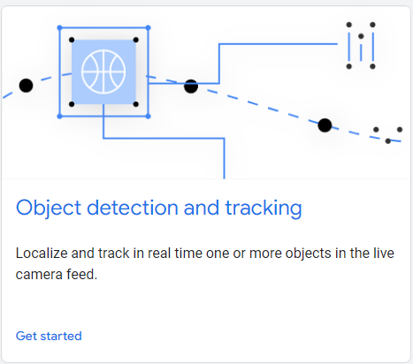
RESEARCH METHODOLOGY
Quantitative Data Analysis
Instrument: Android Application using Media and Google's ML Kit - Vision APIs.
Deep learning pre-trained models.

Slide 22

RESEARCH METHODOLOGY
Quantitative Data Analysis - Video processing applying Vision AI analysis.

Slide 23
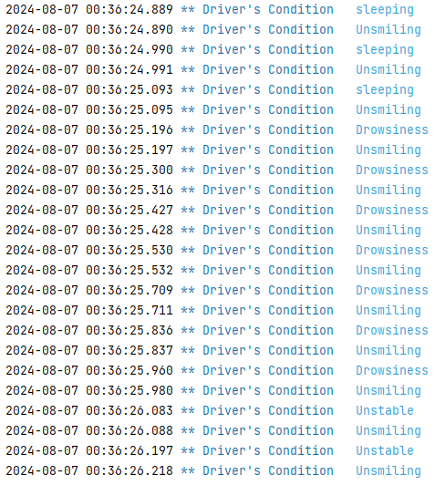
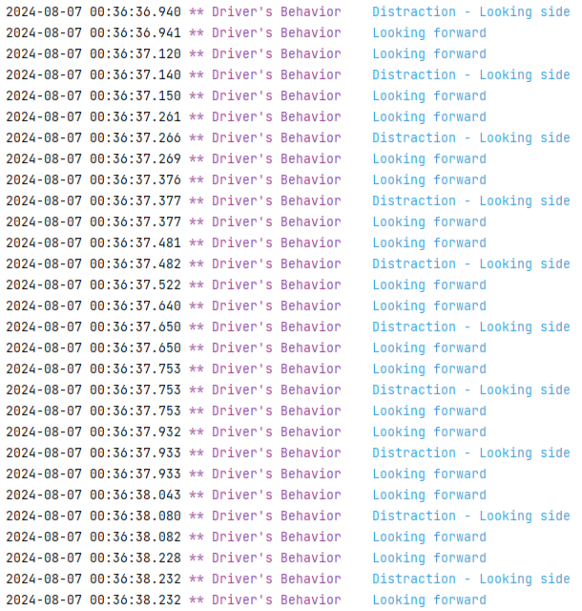
RESEARCH METHODOLOGY
Quantitative Data Analysis - Video processing applying Vision AI analysis.

Slide 24

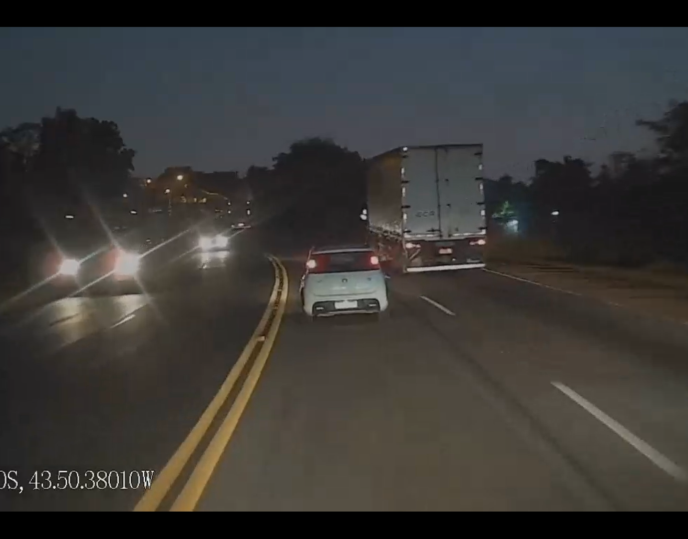
RESEARCH METHODOLOGY
Data Collection - Experiment Two (27 truck drivers)
Latam
INTERNAL VIEW
FRONT VIEW

Slide 25
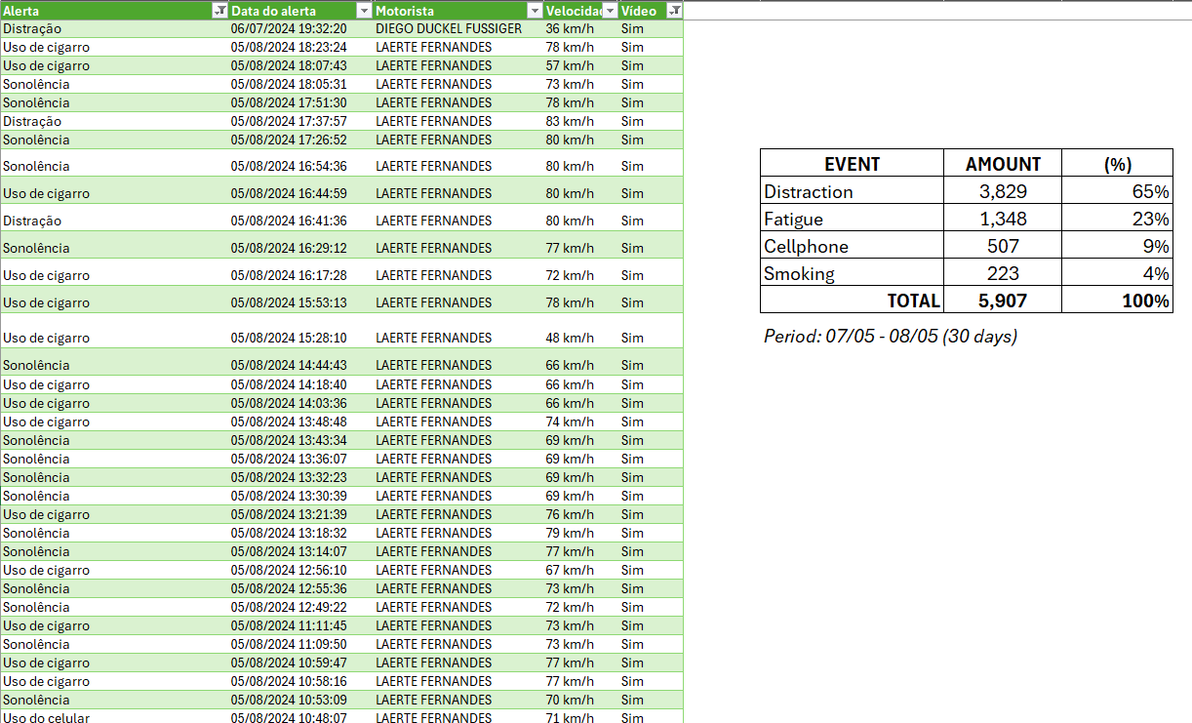
RESEARCH METHODOLOGY
Quantitative Data Analysis - Video processing applying Vision AI analysis.

Slide 26

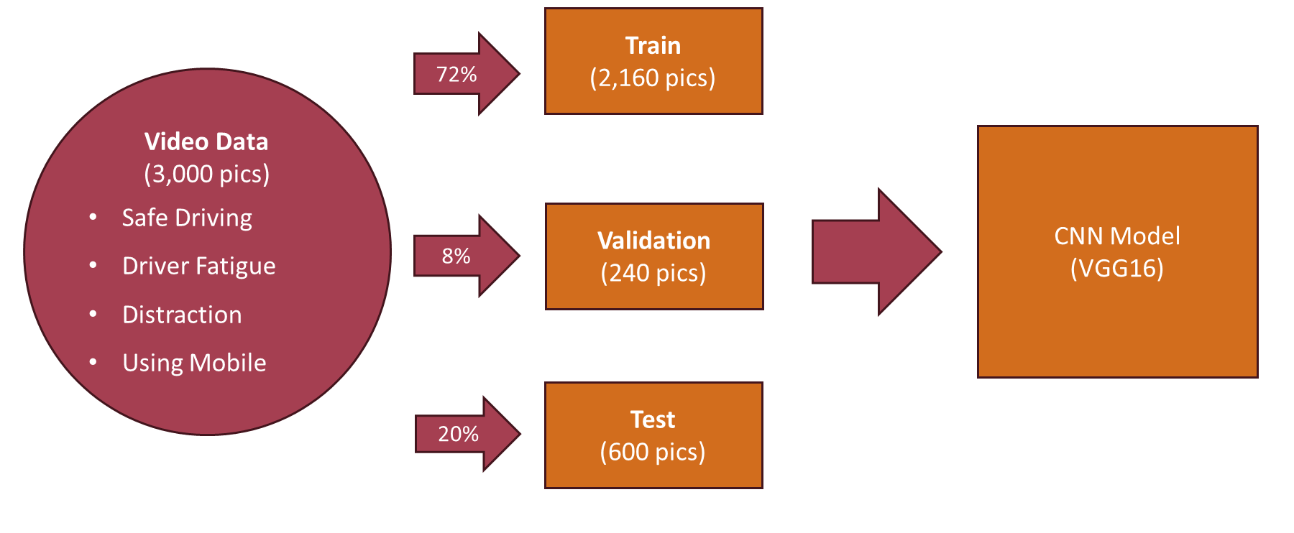
RESEARCH METHODOLOGY
Quantitative Data Analysis
Instrument: Overview of Custom machine learning model.

Slide 27
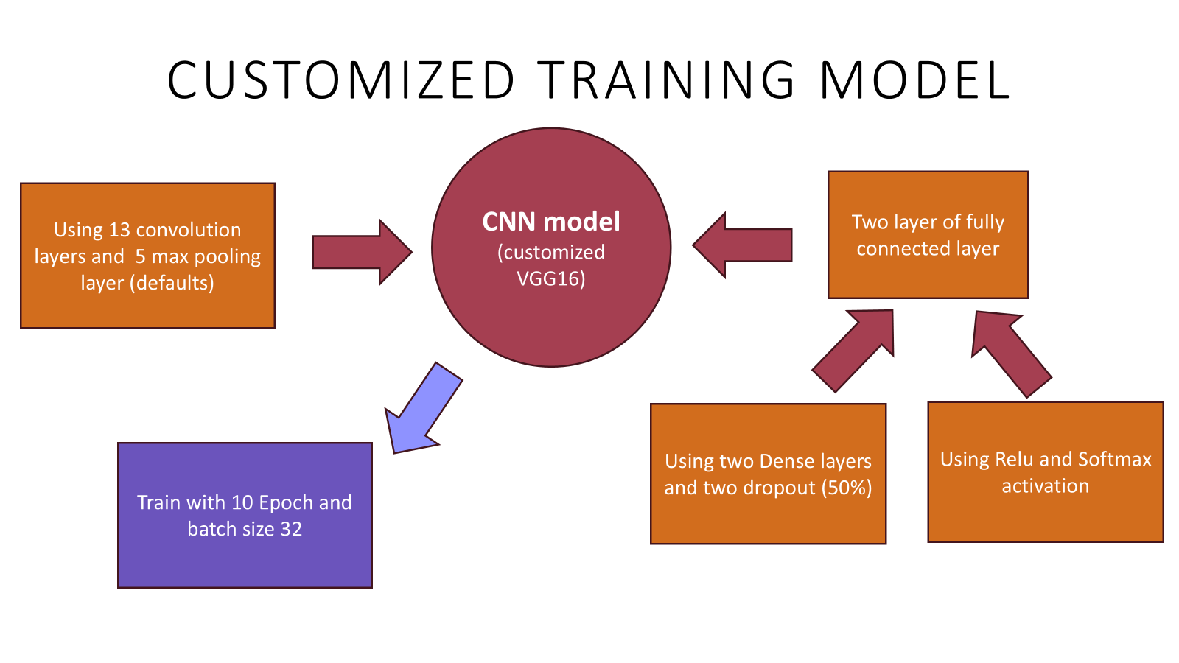

Slide 28
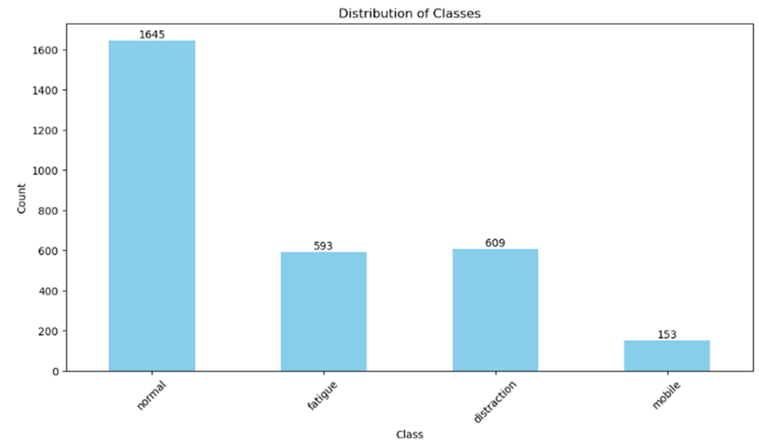
RESEARCH METHODOLOGY
Quantitative Data Analysis
Instrument: Custom machine learning model.

Slide 29
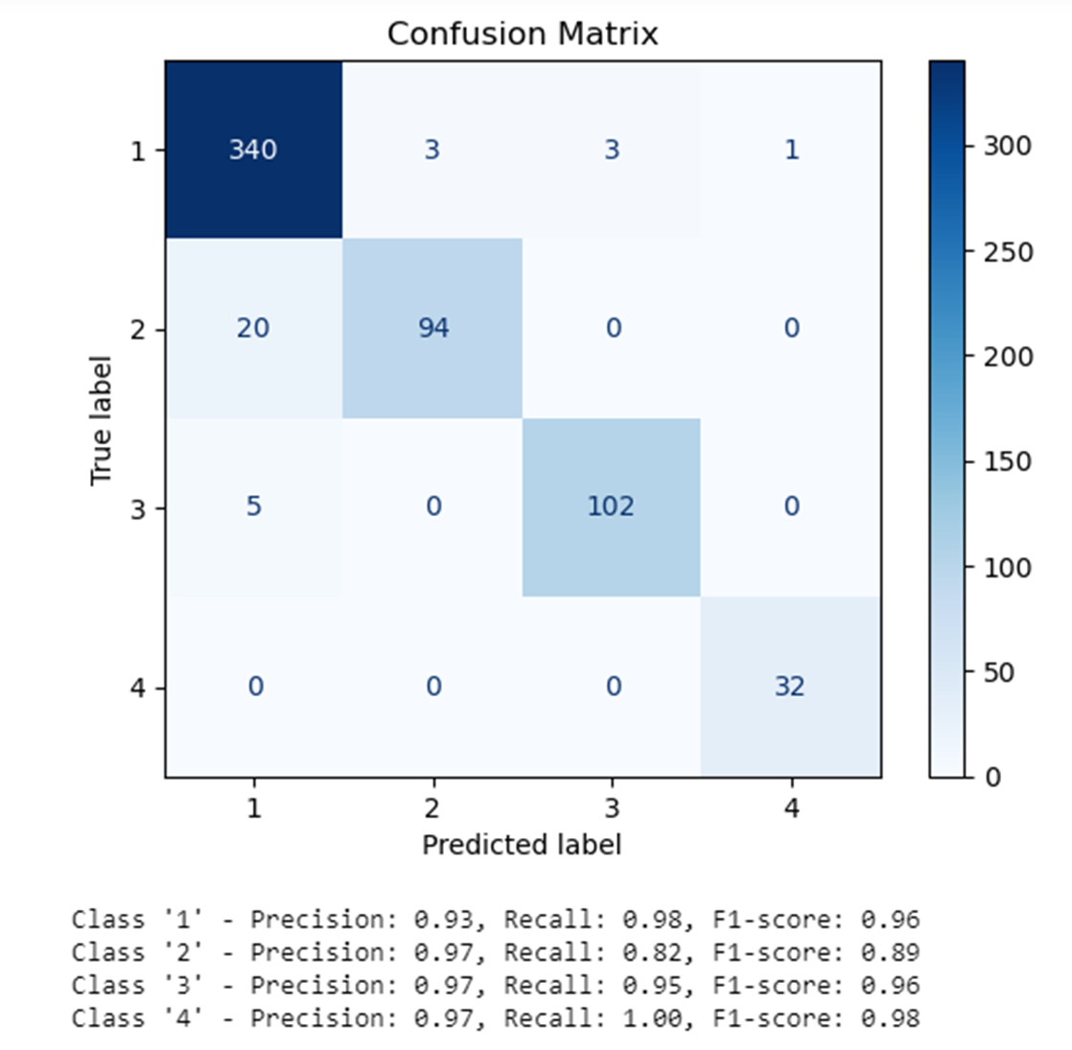
RESEARCH METHODOLOGY
Quantitative Data Analysis
Instrument: Custom machine learning model.
Safe Driving
Fatigue
Distraction
Mobile

Slide 30

RESULTS
QUANTITATIVE FINDINGS
Accuracy:
AI system: 95% accuracy in detecting inappropriate truck driver activities.
High precision, recall, and F1 score.
Enhances road safety significantly.
QUALITATIVE FINDINGS
Interview Themes:
Perceived risk factors: Fatigue, distraction, external risks.
Instruments: Multiple cameras (front, internal, side) integrated with telematics.
Procedures for potential risk scenarios.
Positives:
Real-time analysis and action, locally and remotely.
Monitoring encourages compliance with rules.
Excellent results with company board support.

Slide 31
RESULTS
Challenges
Need for continuous improvement of facial recognition, object, and behavior algorithms. Influencing Variables:
Driver's physical traits (eyes, mouth, beard) and behavior (gestures).
Camera positioning, lighting, vehicle type, weight affecting safety parameters.
Comparative Analysis (AI vs. Traditional Monitoring):
AI more efficient in detecting risky behaviors, especially fatigue and distraction.
Traditional systems depend on manual inputs, past event analysis, or direct observation.

Slide 32
DISCUSSION
Interpretation of Findings:
AI technology reduces accidents but is most effective when combined with other technological, operational, and human factors.
AI cameras can identify risks, like nearby vehicles or driver yawning, but accuracy is influenced by external factors (weather, road quality, load weight).
Customization of ML models is necessary, along with integration with other vehicle inputs (driver’s smartphone data, vehicle electronics).
Implications for Road Safety:
Implementing video-capturing AI in trucking could significantly reduce accidents caused by human error.
AI enhances real-time risk detection, leading to safer driving practices and potential accident prevention.

Slide 33
DISCUSSION
Limitations:
Small sample size and short duration limit the study's generalizability.
Results need validation through larger and longer-term studies.
Privacy concerns regarding AI monitoring require further exploration.
Suggestions for Future Research:
Explore the long-term effects of AI on driver behavior and safety outcomes.
Develop privacy-preserving AI systems that monitor behavior without infringing on personal privacy.
Investigate the integration of AI with other safety systems for more comprehensive risk management.

Slide 34

CONCLUSION
In conclusion, our research
Evaluated how video-capturing AI is currently being used in the trucking industry
Measured the accuracy of AI in predicting risks by analyzing driver behavior.
Compared the real-time monitoring efficiency of AI to traditional systems and collected feedback on its impact on road safety
Practical Recommendations
Promote a Safety-First Culture, Integrate AI with Existing Safety Protocols, Monitor and Review Performance, Adopt Video Capturing AI system
Notes:
In conclusion, our research highlights the powerful impact of video-capturing AI technology in the trucking industry.
This technology is very accurate at predicting potential risks, which helps in preventing accidents before they happen.
Compared to human supervisors and traditional systems, video-capturing AI is better at spotting and tracking driver behavior.
Using this AI technology is making the roads safer and the trucking industry more efficient.

Slide 35

REFERENCES
Bureau of Transportation Statistics (October 19, 2023) - Modal Profiles: U.S. Freight Transportation with Canada, Mexico, and China. https://www.bts.gov/data-spotlight/modal-profiles-us-freight-transportation-canada-mexico-and-china
Esra Civik, Ugur Yuzgec (June 2023) - Real-time driver fatigue detection system with deep learning on a low-cost embedded system.Real-time driver fatigue detection system with deep learning on a low-cost embedded system - ScienceDirect
Government of Canada (July 31, 2022) - Canadian Charter of Rights and Freedoms - Section 7 – Life, liberty and security of the person. https://www.justice.gc.ca/eng/csj-sjc/rfc-dlc/ccrf-ccdl/check/art7.html
Government of Canada (March 25, 2024) - Canadian Motor Carriers, Commercial Vehicles and Drivers. https://tc.canada.ca/en/road-transportation/motor-vehicle-safety/motor-carriers-commercial-vehicles-drivers
Guangnan Zhang, Kelvin K.W. Yau, Xun Zhang, Yanyan Li (February 2016) - Traffic accidents involving fatigue driving and their extent of casualties. https://www.sciencedirect.com/science/article/abs/pii/S0001457515301159?via%3Dihub
Kunpeng Zhang, Shipu Wang, Ning Jia, Liang Zhao, Chunyang, Li Li (April 2024) - Integrating visual large language model and reasoning chain for driver behavior analysis and risk assessment. Integrating visual large language model and reasoning chain for driver behavior analysis and risk assessment - ScienceDirect.
McCarthy J, Minsky M, Rochester N, Shannon C. (1956). A Proposal for the Dartmouth Summer Research Project on Artificial Intelligence. https://ojs.aaai.org/aimagazine/index.php/aimagazine/article/view/1904
Menzies, James (April 15, 2024) - Zero Fatalities: Volvo’s other road to zero. https://www.trucknews.com/health-safety/zero-fatalities-volvos-other-road-to-zero/1003184357/
Ministry of Transport/Government of Canada (2022) - Canadian Motor Vehicle Traffic Collision Statistics: 2022. https://tc.canada.ca/en/road-transportation/statistics-data/canadian-motor-vehicle-traffic-collision-statistics-2022
Tunc Taner, Hasan Tolga Unal, Arif Furkan Mendi, Omer Ozkan, Mehmet Akif Nacar (2023) - Artificial Intelligence Based Transportation System. https://ieeexplore.ieee.org/document/10156716
Yun Zheng, Yuliang Ma, Jared Cammon, Songjie Zhang, Jianhai Zhang, Yingchun Zhang (August 2022) - A new feature selection approach for driving fatigue EEG detection with a modified machine learning algorithm. https://www.sciencedirect.com/science/article/pii/S0010482522004966
Zouhair Elamrani Abou Elassad, Hajar Mousannif, Hassan Al Moatassime, Aimad Karkouch (January 2020) - The application of machine learning techniques for driving behavior analysis: A conceptual framework and a systematic literature review. https://www.sciencedirect.com/science/article/abs/pii/S0952197619302672

Slide 36
THANK YOU

